Slide 1
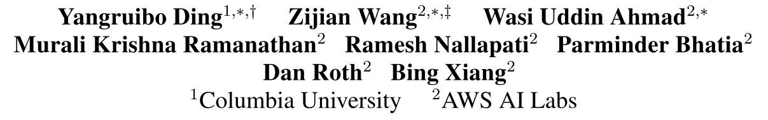
CoCoMIC: Code Completion By Jointly Modeling In-file and Cross-file Context
arXiv: 2212.10007
2023.2.11
Notes:
第一个一作是 NatGen，Codit 和 (Dis)-Similarity of Source Code 的作者之一

Slide 2
Abstract
Motivation: Code LMs complete code conditioned only on the contents within the file, ignore the rich semantics in other files within the same project
Approach: Locates and retrieves the most relevant cross-file context. Learn the in-file and cross-file context jointly
Experiments: Improves the existing code LM with a 19.30% relative increase in exact match and a 15.41% relative increase in identifier matching for code completion
CoCoMIC: Code Completion By Jointly Modeling In-file and Cross-file Context

Slide 3
Problem
Modular programming divides the complex software functionality into several independent components (e.g., files, classes, and functions)
Developing under the modular programming paradigm requires knowledge from the current file and the whole project (cross-file context)
Code LMs only considers in-file context and lacks visibility to various significant references for code completion
generating hallucinated class member functions
function calls with unexpected arguments
CoCoMIC: Code Completion By Jointly Modeling In-file and Cross-file Context

Slide 4
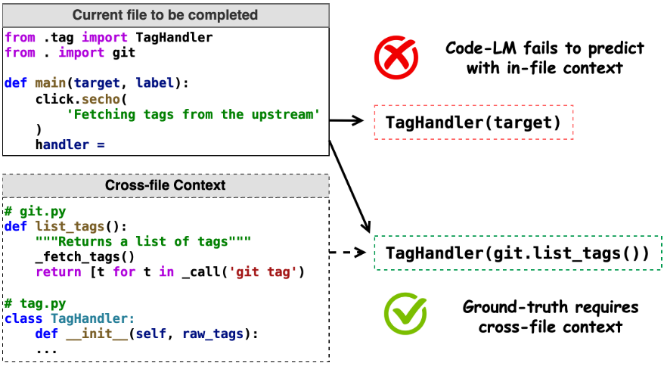
Problem
Code LMs only considers in-file context and lacks visibility to various significant references for code completion
CoCoMIC: Code Completion By Jointly Modeling In-file and Cross-file Context

Slide 5
Challenges
How to identify the most relevant and useful cross-file context
project could be of varied sizes and always defines its individual and complex hierarchy
How to aggregating the information from the in-file and cross-file contexts
in-file and cross-file contexts represent distinct types of contextual information
model’s input length is limited
CoCoMIC: Code Completion By Jointly Modeling In-file and Cross-file Context

Slide 6
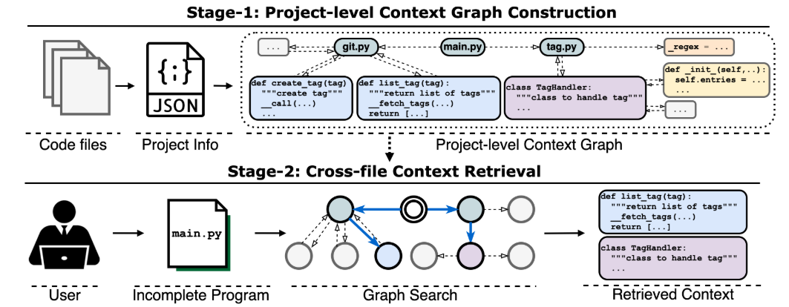
CCFinder: Cross-file Context Finder
Builds a project context graph + Retrieve the neighbors as the cross-file context
CoCoMIC: Code Completion By Jointly Modeling In-file and Cross-file Context

Slide 7
CCFinder: Cross-file Context Finder
Project-level Context Graph: Entities & Relations
Project Entities: files, global variables, classes, functions
file: file names and file docstrings
global variable: variable names and their values
class: class signatures, docstrings, and fields
function: function signatures, docstrings, and bodies
CoCoMIC: Code Completion By Jointly Modeling In-file and Cross-file Context

Slide 8
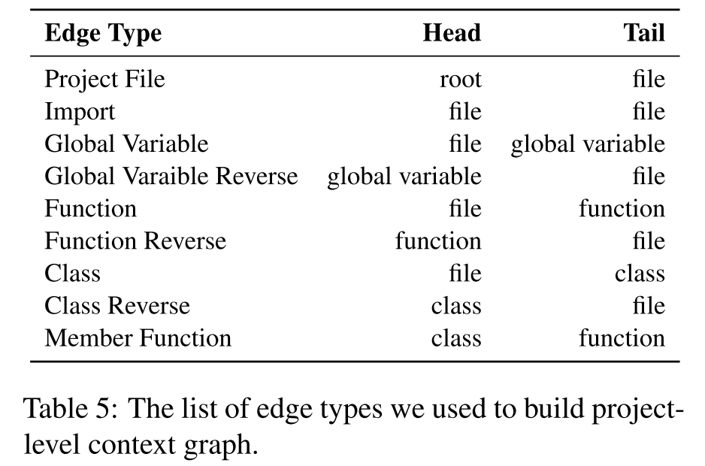
CCFinder: Cross-file Context Finder
Project-level Context Graph: Entities & Relations
Entity Relations: intra-file, inter-file
CoCoMIC: Code Completion By Jointly Modeling In-file and Cross-file Context

Slide 9
CCFinder: Cross-file Context Finder
Build Project-level Context Graph
create a root node for the project and connect it with all file nodes
each file node builds its own sub-graph from top to down
build edges between files according to the import statement
CoCoMIC: Code Completion By Jointly Modeling In-file and Cross-file Context

Slide 10
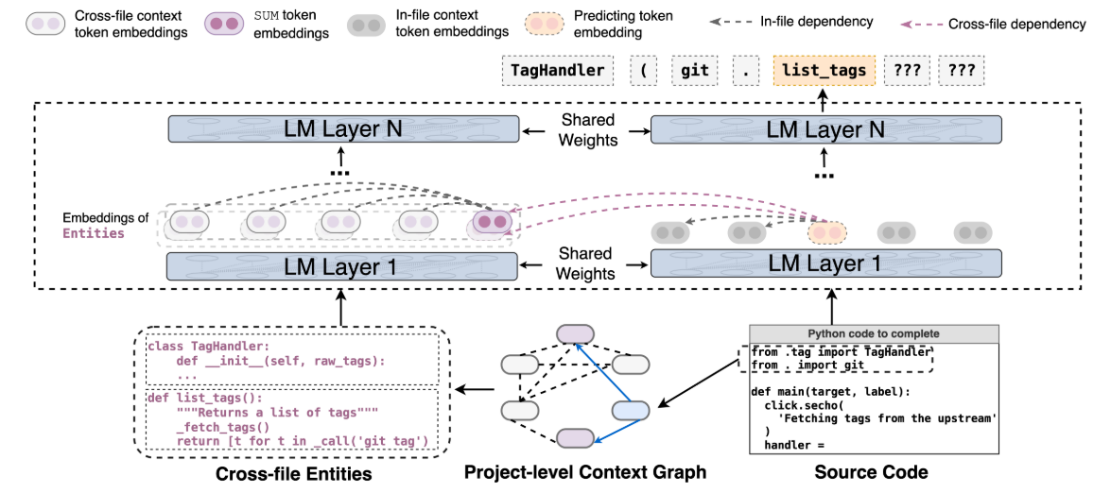

CCFinder: Cross-file Context Finder
Cross-file Context Retrieval
extract the import statements from the incomplete code file
locate these imported entities in the project-level context graph
retrieve their neighbors within $k=2$ hops
re-order the nodes in original code order
CoCoMIC: Code Completion By Jointly Modeling In-file and Cross-file Context

Slide 11


CoCoMIC
CoCoMIC: use a shared decoder-only LM to encode:
in-file code snippet
retrieved-context entities
at max 128 project entities, each entity contains up to 128 tokens
CoCoMIC: Code Completion By Jointly Modeling In-file and Cross-file Context

Slide 12
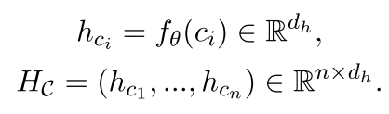
CoCoMIC
Encoding cross-file context into a single representation.
Input to model:
locale: indicates context’s hierarchical relationship as a comment
[SUM]: a special token to learn the summarization of the entity
Takes the hidden state of the last token [SUM]:
# git.list_tags
def list_tags():
CoCoMIC: Code Completion By Jointly Modeling In-file and Cross-file Context
Notes:
跨文件上下文包含很多信息，而其中只有小部分与当前目标相关，对每个跨文件实体只保留长度为1的表示

Slide 13
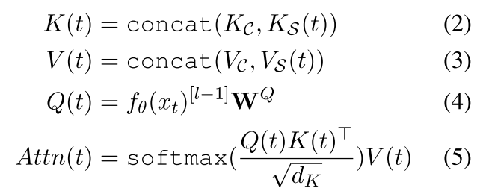
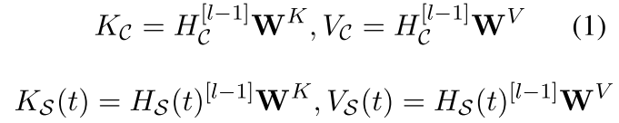
CoCoMIC
Modeling In-file and Cross-file Context for Code Completion
in-file context
cross-file context
Joint attention to In-file and Cross-file Context
CoCoMIC: Code Completion By Jointly Modeling In-file and Cross-file Context

Slide 14
Experiment Data
Data Source: Python Package Index (PyPI) data
filter out packages with too few files (<5)
filter out packages with too large project-context graph (>5k nodes)
ending up with 60,891 packages
Divide the dataset into train, validation, and test
80%, 10%, 10%
split with different sets of packages
only include projects with no leakage as test data (packages like numpy are widely used)
create prompts by cutting the source file at the location where completion requires cross-file contexts for testing
ended up with 15k held-out prompts for evaluation
CoCoMIC: Code Completion By Jointly Modeling In-file and Cross-file Context

Slide 15
Experiment Setup
CoCoMIC Model: finetuned CodeGen-350M-Mono
Task: statement-level completion
Baselines: CodeGen-350M-Mono
zero-shot
finetune w/o cross-file context
finetune w/ cross-file context, reserve 128 tokens
Evaluation Metrics
exact match (EM) and BLEU-4
exact match, precision, and recall of identifiers (API usage)
CoCoMIC: Code Completion By Jointly Modeling In-file and Cross-file Context

Slide 16
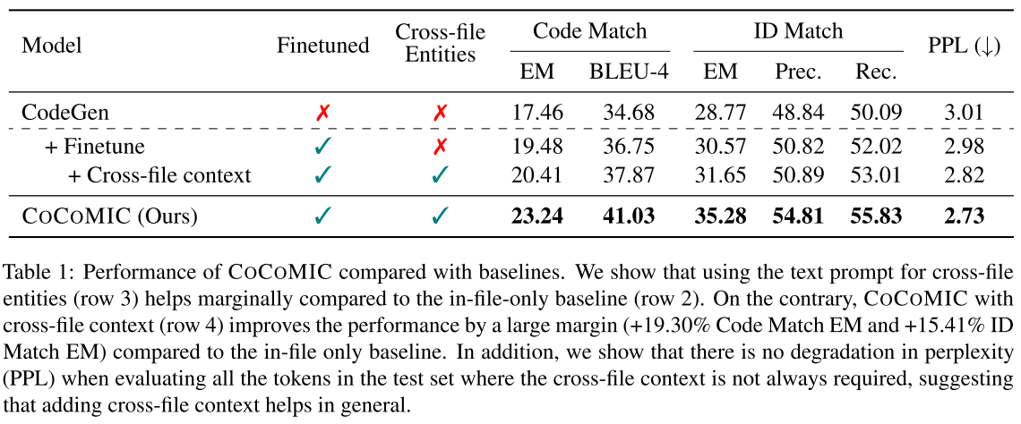
Results
CoCoMIC: Code Completion By Jointly Modeling In-file and Cross-file Context

Slide 17
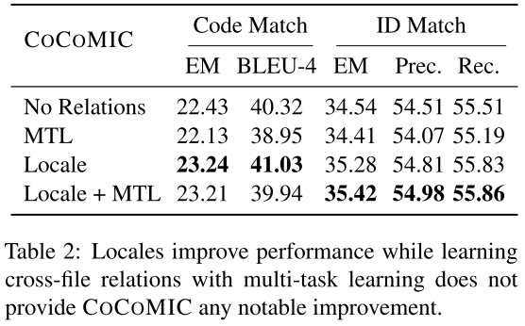
Analysis
Locales help CoCoMIC learn better cross-file context
MTL: train the model with an auxiliary edge prediction task among cross-file entities. (97.2% accuracy)
CoCoMIC: Code Completion By Jointly Modeling In-file and Cross-file Context

Slide 18
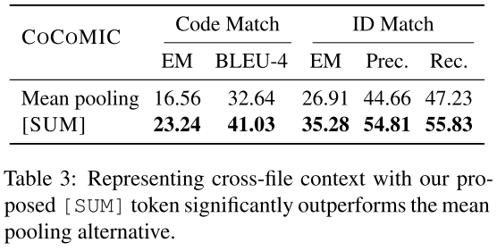
Analysis
[SUM] token effectively summarizes cross-file contexts and significantly outperforms the mean pooling strategy
CoCoMIC: Code Completion By Jointly Modeling In-file and Cross-file Context

Slide 19
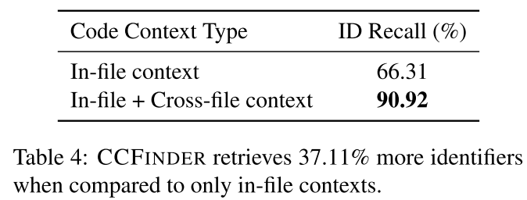
Analysis
Does CCFinder Retrieve Relevant Cross-file Context?
while CCFinder increases identifier recall by 37.11%, only a 3.81% improvement in predict identifier recall of CoCoMIC
CoCoMIC: Code Completion By Jointly Modeling In-file and Cross-file Context

Slide 20
Conclusion
Bring the cross-file context into the view of the model
Compress the representation of cross-file entries to extract key information
While CCFinder increases identifier recall by 37.11%, only a 3.81% improvement in predict identifier recall of CoCoMIC
CoCoMIC: Code Completion By Jointly Modeling In-file and Cross-file Context

